Slide 1
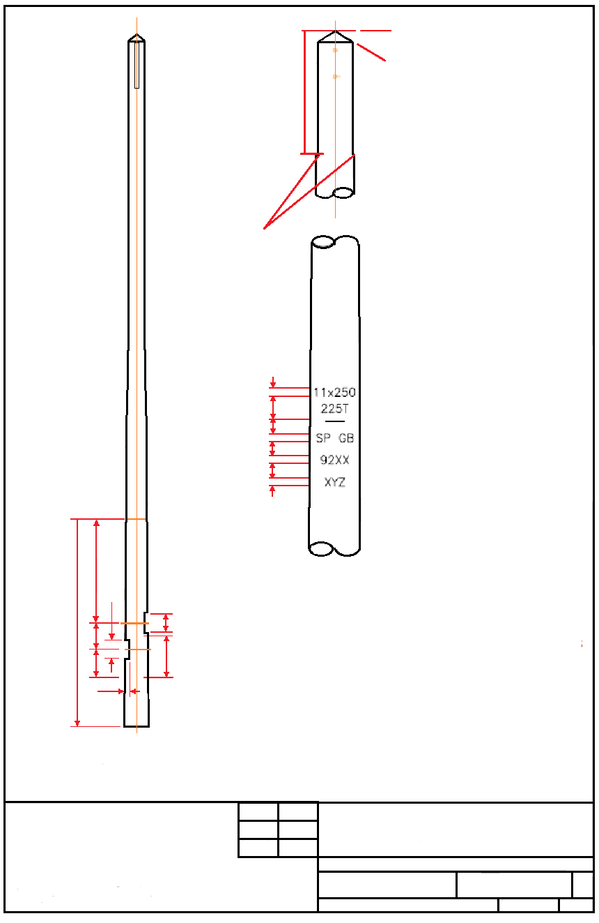

30⁰
750
SCARFING TO BE CUT TO GIVE
A 50mm FACE ON BOTH FACES
OF POLE AND THE END
CHAMFERED OFF BEYOND
THE LENGTH SHOWN
45⁰ CHAMFER
25
MARKING GENERALLY AS BS1990
LENGTH AND DIAMETER OR CLASS AT 1500mm
CHARACTERS TO BE GOUGED OR BRANDED 5mm WIDE, 3mm DEEP AND 25mm HIGH AS A MINIMUM
POLE TOP DIAMETER
TIMBER SPECIES, COUNTRY OF ORIGIN
YEAR OF PRESERVATION AND CHARGE No.
INITIALS OF SUPPLIER
90
30
25
30
25
30
25
DIM ‘A’
NOTES:-
ALL DIMENSIONS ARE IN MILLIMETERS, UNLESS OTHERWISE SHOWN
ALL POLE DRILLINGS ABOVE GROUND LEVEL WHICH ARE NOT USED, MUST BE PLUGGED WITH APPROVED WOOD POLE PLUGS
3000
255
255
380
410
600
25
POLE LENGTH (m) | DIM ‘A’ (m)
8.5 – 11.0 | 1.7
11.5 – 14.0 | 1.5
15.0 – 17.0 | 1.3
18.0 – 24.0 | 1.1
POLE SIZE TO BE IMPRESSED ON POLE BUTT
KK POLE FABRICATION DRAWING
DRG. & ISSUE
NG-KK-001
1

